Slide 1
Community ART for Retention in Zambia:
Urban Adherence Groups (UAG)
Centre for Infectious Disease Research in Zambia (CIDRZ)
In partnership with the Zambian Ministry of Health
Sponsor: Bill & Melinda Gates Foundation
19th September 2018
Collaborators: James Cooke University, Johns Hopkins, UAB, UCSF, UNZA
Notes:
I am honored to be here today, presenting our findings on the implementation and effectiveness of Urban Adherence Groups (UAGs), also known as Urban Adherence Clubs (UACs) on behalf of the community ART study team.

Slide 2
Measurements
Outcomes after 12 months
Electronic medical record (Smartcare)
UAG meeting attendance register
UAG departure log
In-depth interviews and focus group discussions with health care workers and patients (Nvivo QSR)
Primary Outcome
  Patient retention in care:
  missed drug pick-up > 7 days late
Secondary Outcomes
  14 or 28 days late,
Implementation outcomes: acceptability, appropriateness, adoption, feasibility, fidelity
Notes:
We gathered information on patient characteristics and time to drug pick-up from SmartCare, which helped with the primary and secondary clinical outcomes. [BE SURE TO CLICK ENTER TWICE]
The group register and depature log helped us to track attendance at meetings and departure from group or clinic while interviews and focus group discussions with both HCWs and patients helped us understand [CLICK/HIT ENTER] the acceptability, appropriateness and feasibility.

Slide 3
Patients (N=1096) similar in both groups at baseline
Notes:
We had 5 intervention and 5 control sites matched for clinic population and urbanicity. There were more patients in the intervention than control grops but both populations were similar at baseline in terms of sex, age, enrollment who stage, CD4 count both when enrolled in HIV care and in study, time on ART, estimated proportion of time patient had ART in their possession and late drug pick-up in the last year

Slide 4
43(~7%) of UAG members had left their group by the end of the study
Reason for UAG departure | n (%)
Pregnancy | 10 (23%)
Transfer to another clinic | 9 (21%)
Loss to follow-up from care | 6 (14%)
Patient preference for facility-based care | 4 (9%)
Patient not following UAG code of conduct | 4 (9%)
Diagnosed with tuberculosis | 4 (9%)
Other | 3 (7%)
Death | 3 (7%)
Total | 43 (100%)
Notes:
At the end of the study about 7% had left the study. After about 3 months, patients started leaving usually due to being sent to MCH when pregnant or transferred to another clinic. Less than 1% of the 594 UAG members left because they preferred facility-based care and Less than 1% of the 594 were removed for not following code of conduct

Slide 5
High level of acceptance
597
594
594
592
Notes:
Of the 597 offered , 594 (99%) accepted to join UAGs/ UACs and most attended at least one meeting

Slide 6
Number of missed UAG visits per participant
Notes:
Looking at attendance at scheduled appointments among UAG participants, 40% attended all visits. Though the majority missed one or more visits, this does not necessarily mean a missed pharmacy pick-up [SWITCH TO NEXT SLIDE]

Slide 7
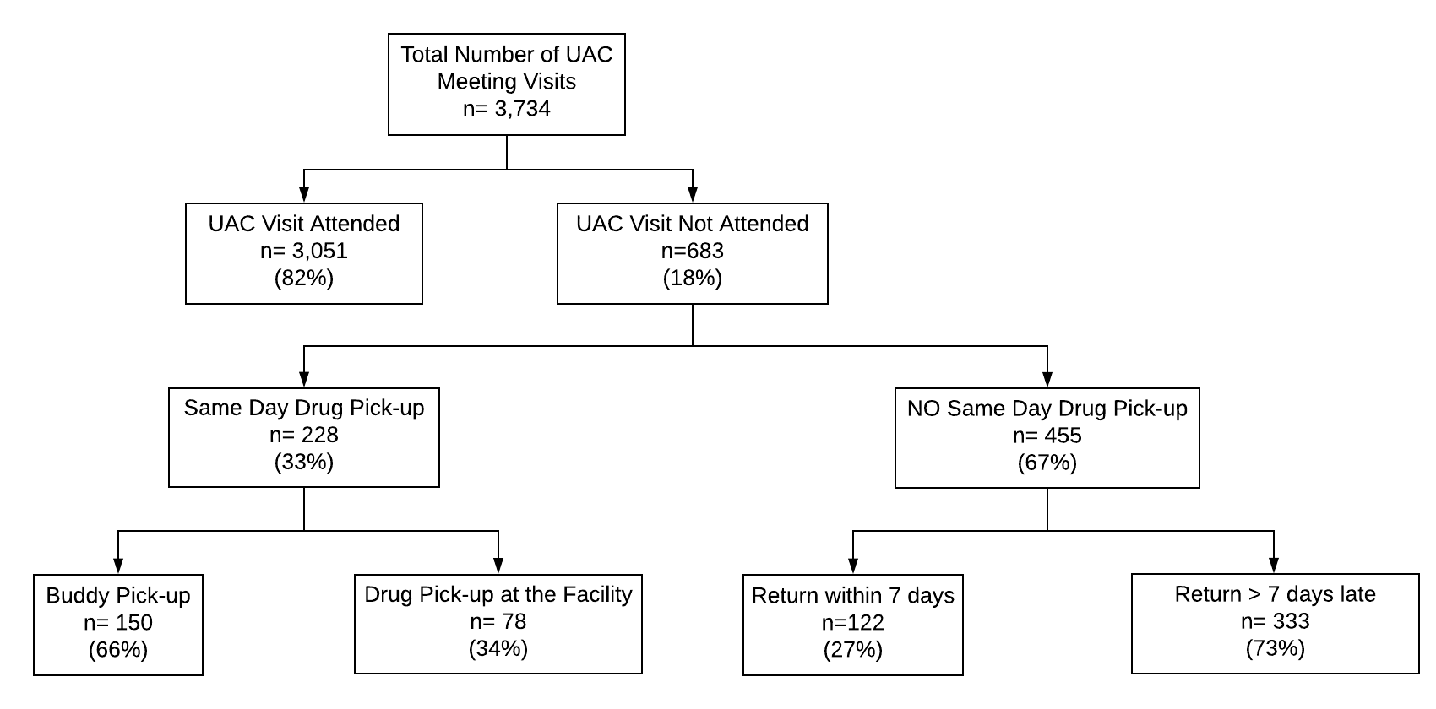
Half of missed UAG meetings did not delay ART pick-up by more than 7 days
Of the 683 unattended visits, drug-pick up within 7 days still occurred in 350 (51%) of visits
Notes:
Of the UAG meetings that were missed, a 3rd still resulted in a same day drug pick up either by a buddy who came to the UAG meeting or the patient showing up at the clinic on the same day. These along with attended visits means that 88% of the scheduled meetings resulted in ARVs being picked up on the same day. Also as shown in the red box,

Slide 8
Time to drug pick-up after missed UAG meeting (N=455)
Cumulative incidence of return after missed drug pick-up:
  26% at 7 days
  37% at 14 days
  47% at 28 days
Notes:
Of the 455 who did not pick ARVs on the same day, about half had returned by the 28th day of the meeting.

Slide 9
Patients valued group support
“At general ART I never had an opportunity to interact with the staff here maybe because by the time you are getting in, they are tired and sometimes they would look moody and shout at us. So you would fear to ask questions even when you want to find out about something that is troubling you. But from the time I joined this group, I am very free to ask any question and I have learnt a lot.”
FGD Manungu Male Participant
Notes:
It is possible that 80% of the UAG meetings were attended because people valued group support.
In FGDs,
Both health care workers and patients agreed UAgs were generally appropriate in terms of clinical care, pscyho-social outcomes and reduction in disengagement from care
Patients said it
Reduced stress and logistics in accessing medication
Improved access to information and support during group sessions
However, Health Care Workers suggested that
one-on-one counselling was more effective and appropriate
Members should be required to be on ART for 12 months (instead of 6)

Slide 10
Intervention group more likely to pick up drugs
Control: 0.62 (95% CI: 0.58 - 0.66)
Control: 0.46 (95% CI: 0.41 – 0.50)
Intervention: 0.27 (95% CI: 0.24 - 0.31)
Intervention: 0.20 (95% CI: 0.17 - 0.24)
7 Days Late
28 Days Late
Log-rank test: p < 0.0001
Log-rank test: p < 0.0001
Notes:
In these graphs, The X axis shows Time (1 year follow up) and Y the Incidence of failure to pick up (Classifying failure as at least 7 days and at least 28 days late) The Blue line shows the control and the red intervention . Our preliminary analysis shows that intervention group has significantly better retention.

Slide 11
Predictors of late drug pick up at 7 days among intervention and control participants
Predictor | Unadjusted Odds Ratio | 95% CI | Adjusted Odds Ratio | 95% CI
Control (Standard of Care) | 4.31 | 3.32 – 5.59 | 5.34 | 1.94– 14.7
Male Sex | 1.37 | 1.06 – 1.76 | 1.62 | 1.17 – 2.23
Age at enrollment | 0.98 | 0.97 – 0.997 | 0.995 | 0.98 – 1.01
Time since ART Initiation | 0.97 | 0.93 – 1.01 | 0.95 | 0.90 – 1.01
WHO Stage III or IV or CD4 < 200 cells/mm³ at HIV care enrollment | 0.89 | 0.67 – 1.17 | 1.15 | 0.98 – 1.00
MPR at study enrollment | 0.99 | 0.98 – 0.999 | 0.99 | 0.98 – 1.004
Notes:
In our multivariate model,
Being Male and in the control group was significantly associated with late drug pick-up (7 days late) at 12 months of follow-up time, indicating that the intervention was beneficial.

Slide 12
Study Limitations
  Duration of follow-up relatively short, limited ability to comment on sustainability and long term outcomes
  Challenges using routine data to determine study outcomes
  Viral load testing in progress, not yet reported
Notes:
Our study had some limiltations. We are not yet able to evaluate the sustainability of the intervention as patients were followed only for 12 months. Challenges with missing data in the EMR led us to manual chart review and enter any missing data in the system. We will evaluate VL suppression using program data as it becomes available.

Slide 13
Conclusions
Twelve-month cumulative incidence of first missed drug pick-up significantly lower among intervention participants at 7 and 28 days compared to controls
UAGs were acceptable and feasible and patient adoption was high
Most patients missed at least one visit, but recovery (drug pick-up within 7 days of missed visit) occurred in half of all unattended visits
Migration out of UAGs occurred and was due to changes in clinical status (pregnancy, TB, etc) as well as less commonly, patient preference
Notes:
In conclusion, we found that 12 month cumulative incidence of first missed dug-pick up was significantly lower than in intervention group compared to the controls. We also found that UAgs were acceptable, feasible, and highly adoptable. Over time, the majority of patients missed at least one visit, but same day-drug pickup occurring through other means was frequent. When delayed drug pickup did occur, patients usually returned within 1-2 weeks.

Slide 14
Implications
UAGs are an effective tool in the DSD toolbox for reducing late drug pickup
The frequency of alternative same day drug-pick up argues for the need for DSD models to be flexible and patient-centered
Successful monitoring and evaluation will need to account for migration into and out of DSD models
Notes:
Our findings have several important implications. First, UAGs are an effective tool in the DSD toolbox to reduce late drug pickup and time out of care. Patients may miss UAG meetings. They should be given alternative means of drug-pick up such as a buddy. DSD models need to be flexible and patient-centered. Finally, successful monitoring and evaluation of UAG programs and other DSD models will need to account for frequent migration into and out of the model.

Slide 15



Thank You
Questions?
We would like to thank the Zambian Ministry of Health and all participating patients and health workers.

